Slide 1
MISSISSIPPI PUBLIC HEALTH
Born at Risk
A Mississippi Maternal-Infant Health Priority Index
Which counties need to be prioritized first and why?

Slide 2
PROJECT FOCUS
🏥 SCOPE
The Core
Question
Mississippi maternal and infant health with county-level analysis
🗺️ APPROACH
Where are Mississippi counties carrying the heaviest combined burden?
County-level public health prioritization across all 82 counties
⚠️ METHOD
Focus on overlapping and compounding risks, not single metrics
Low birth weight alone doesn't tell the full story. The barriers surrounding a family matter just as much.
🎯 PURPOSE
To make a decision-support tool not a clinical prediction model

Slide 3
DATASETS USED
CDC PLACES County Data
County Health Rankings Mississippi 2025
01
Diabetes, obesity, hypertension, smoking, physical inactivity, poor physical & mental health, depression, uninsured rates
03
Low birth weight, children in poverty, severe housing, food environment, broadband access, childcare cost burden, provider access
CDC/ATSDR Social Vulnerability Index (SVI)
March of Dimes Mississippi Report Card
02
Poverty, unemployment, disability, single-parent households, no vehicle access, no internet, overall social vulnerability
04
Background context: maternal and infant health significance in Mississippi
🔗 Common Join Key: County FIPS / GEOID — enabling all datasets to connect at the county level

Slide 4
DATABASE DESIGN
SQLite Database: born_at_risk_ms.db
counties
county_health_rankings
Basic county information & FIPS codes
Low birth weight, access indicators
places_health
master_county_data
CDC PLACES health indicators by county
Joined table combining all datasets by FIPS
social_vulnerability
priority_scores
CDC/ATSDR SVI scores & components
Domain scores, final score & priority level

Slide 5
ANALYSIS METHODS
Domain 1: Maternal & Infant Outcome
Domain 3: Social Vulnerability
Low birth weight percentage
CDC/ATSDR overall SVI score
Domain 2: Chronic Disease Burden
Domain 4: Access & Resource Barriers
Diabetes, obesity, high blood pressure
Uninsured rates, no vehicle access
Smoking, physical inactivity
Children in poverty, severe housing
Poor physical & mental health, depression
Childcare cost, food, broadband, providers
Final Priority Score = Average of 4 Domain Scores (percentile 0–100, higher = higher concern, equal weighting)

Slide 6
VISUALIZATIONS
🗺️
📊
🔍
County Priority Map
Top 5 Priority Counties
Domain Score Breakdown
Mississippi-wide geographic view of final priority scores by county
Clear ranked bar chart of highest-scoring counties
Explains WHY top counties rank critical — multiple domains simultaneously high
📉
🖱️
📋
SVI vs. Low Birth Weight
Interactive Hover Map
County Report Card
Scatterplot showing how social vulnerability and infant outcomes co-occur
Users hover to see county name, final priority score, and priority level
Per-county breakdown of all domain scores and indicators

Slide 7
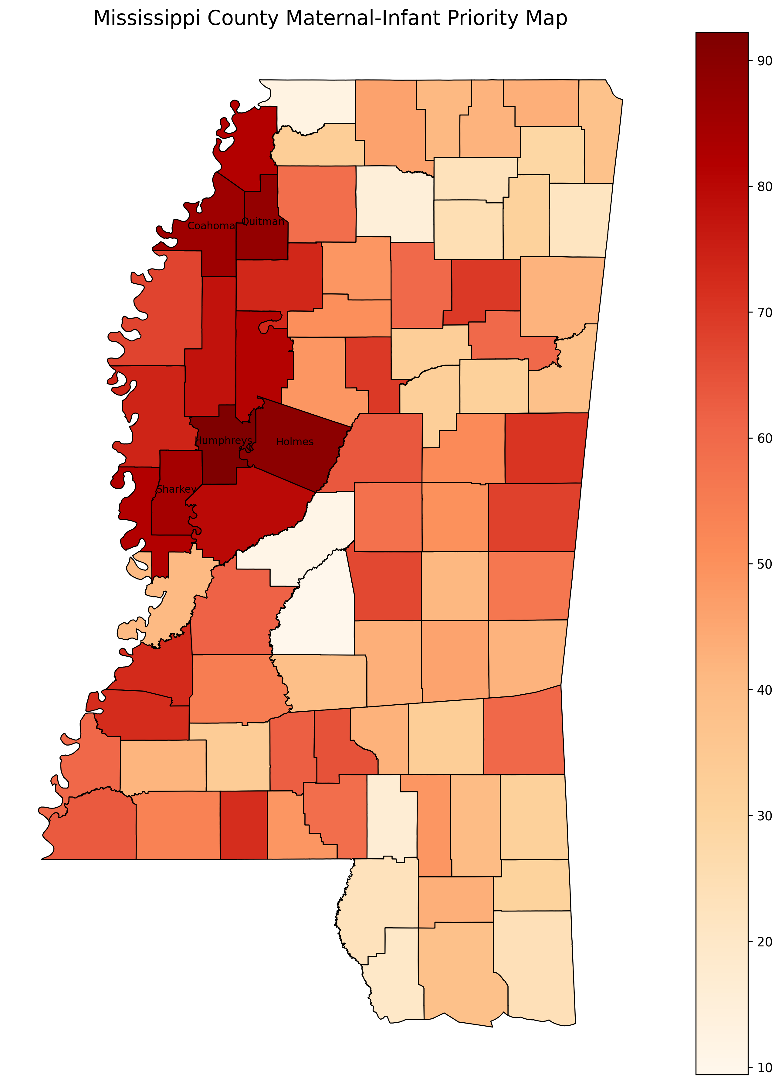
Open Interactive Map
(Crtl + Click)

Slide 8
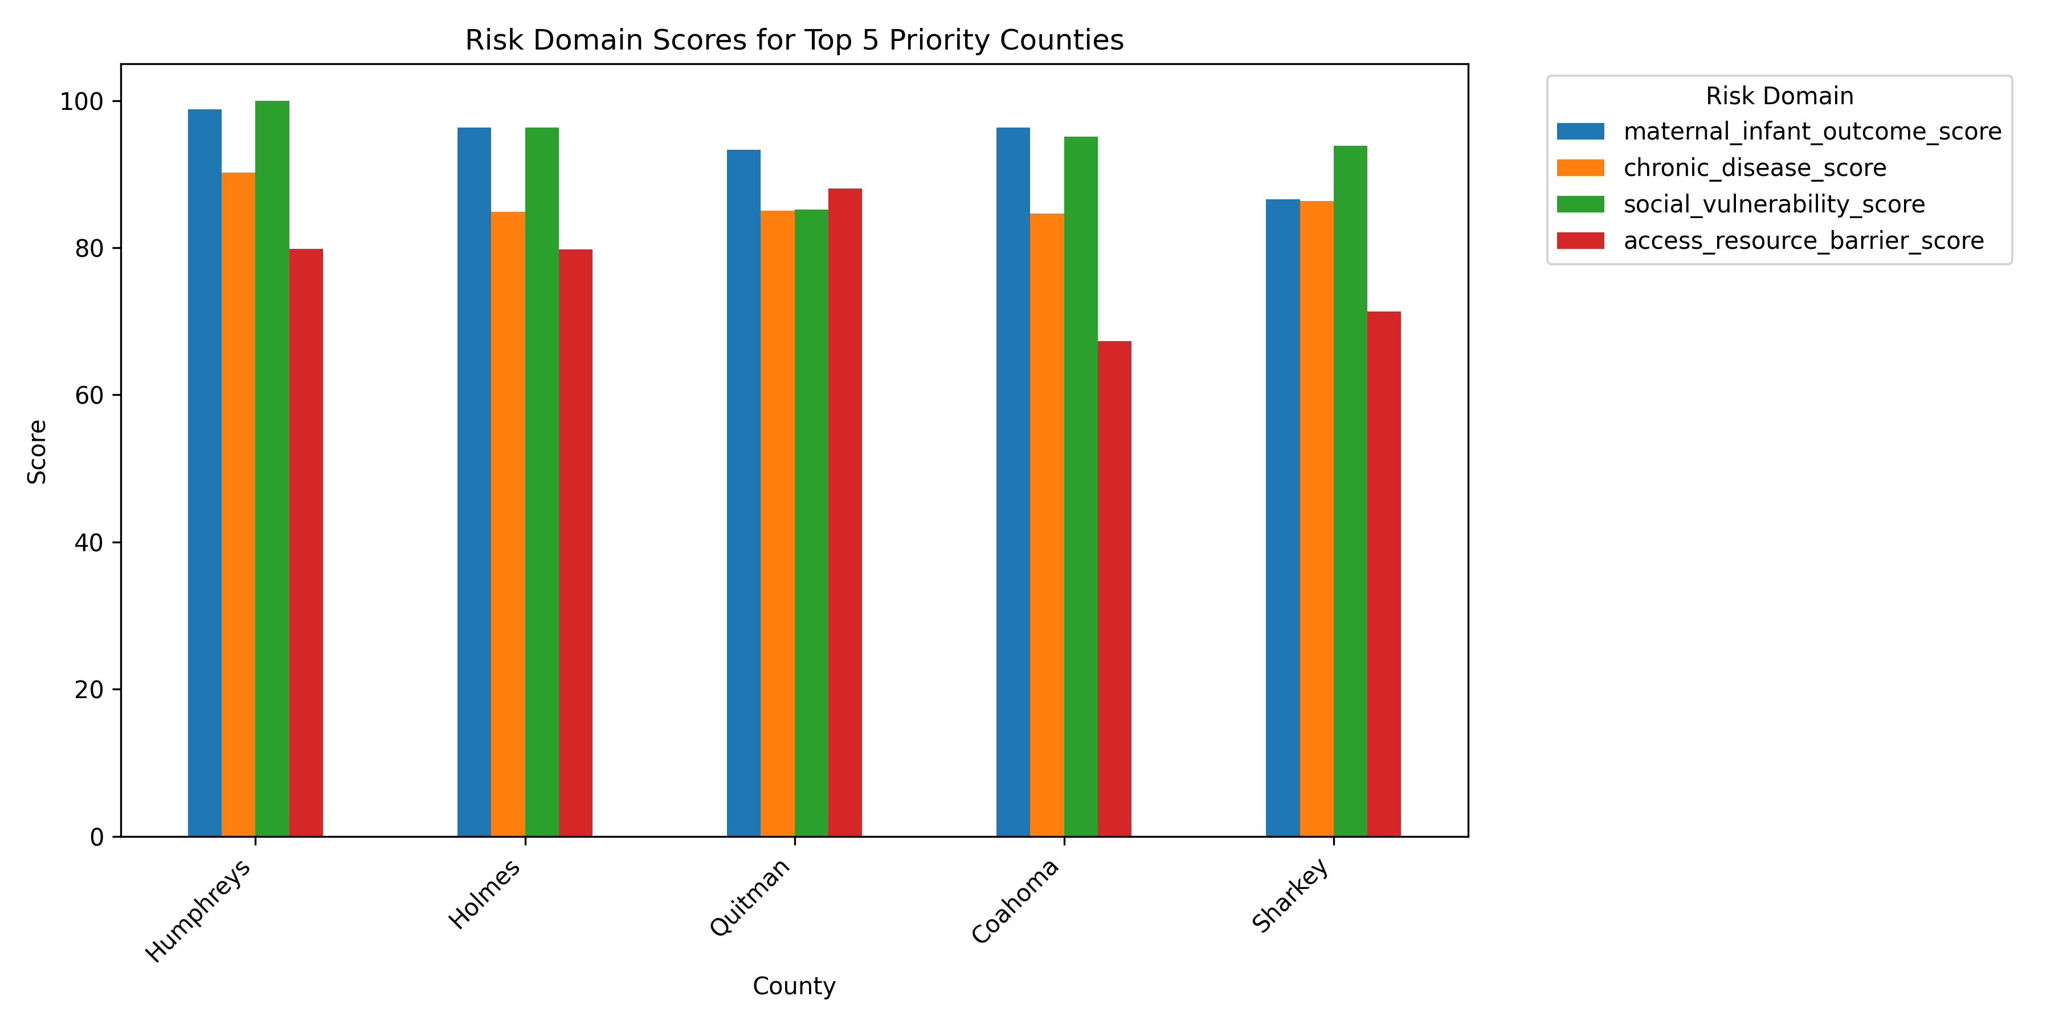

Slide 9
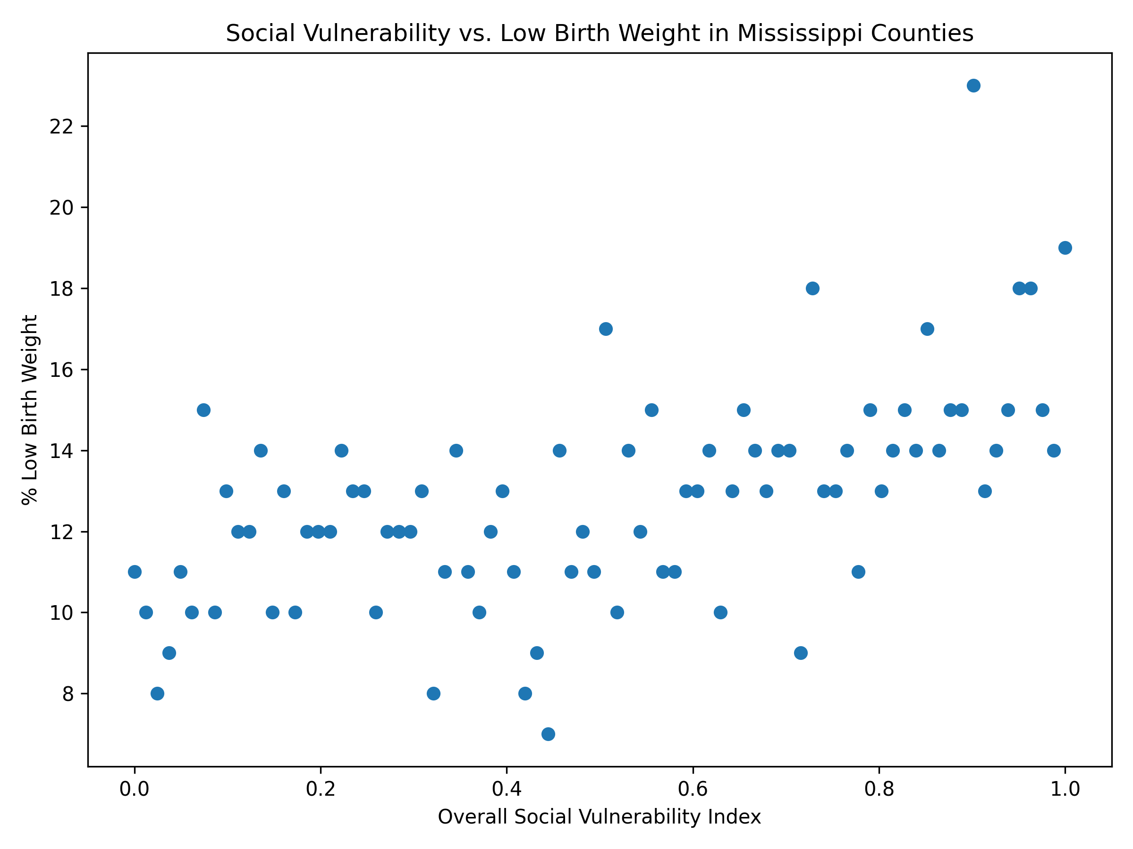

Slide 10
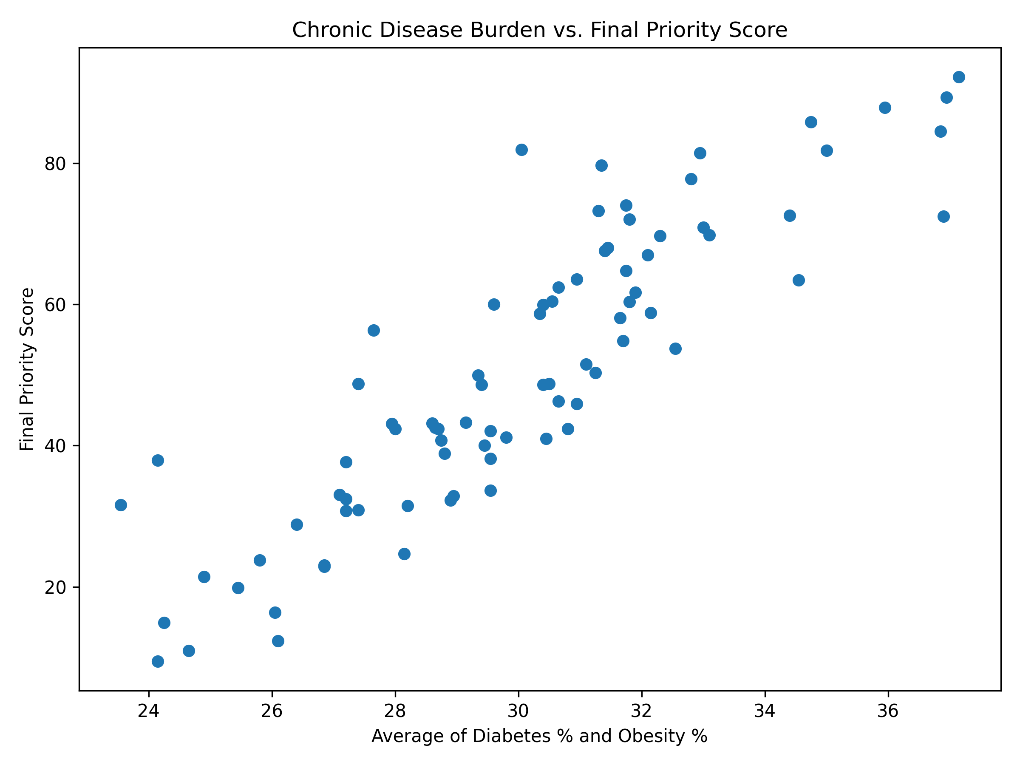

Slide 11
FINDINGS & CONCLUSIONS
TOP 5 HIGHEST-PRIORITY COUNTIES
Main Finding
#1
Humphreys County
The highest-priority counties are not high because of one issue.
They rank high because multiple risk domains overlap simultaneously:
• Very high low birth weight
• High chronic disease burden
• Maximum social vulnerability
• Major access & resource barriers
#2
Holmes County
#3
Quitman County
#4
Coahoma County
#5
Sharkey County
Risk compounds and so must our response.

Slide 12
Every county on this map represents
real families, real mothers, and real babies.
A priority score will not solve maternal and infant health by itself.
But it can help us notice the places where risk is stacking up — before more families fall through the cracks.
Born at Risk: Using public data not just to describe inequality,
but to help target support where it may be needed most.

